Slide 1
Statistical definition of informal employment
-Latest standards from the 21st ICLS of October 2023
Michael Frosch
frosch@ilo.org
Department of Statistics
ILO

Slide 2
Content
  The definition of informal employment
  ICSE-18
  Operational definitions of formal and informal jobs
  Partly informal productive activities in relation to formal jobs
  Essential categories of informal unpaid work

Slide 3
Content
  The definition of informal employment
  ICSE-18
  Operational definitions of formal and informal jobs
  Partly informal productive activities in relation to formal jobs

Slide 4
Definition of informal employment (§§ 56)
    “Informal employment is defined as any activity of persons to produce goods or provide services for pay or profit that is -in law or in practice- not covered by formal arrangements such as commercial laws, procedures to report economic activities, income taxation, labour legislation and social security laws and regulations providing protection against economic and personal risks associated with carrying out the activities”.
Comprises activities carried out in relation to informal jobs held by:
  Independent workers who operate and own or co-own an informal household unincorporated market enterprise;
  Dependent contractors who do not have a formal status in relation to the legal administrative framework or whose activities are not effectively covered by formal arrangements;
  Employees, if their employment relationship is not, in practice, formally recognized by the employer in relation to the legal administrative framework of the country or not associated with effective access to formal arrangements; and
  Contributing family workers whose work relationships are not formally recognized in relation to the legal administrative framework of the country or not associated with effective access to formal arrangements.

Slide 5
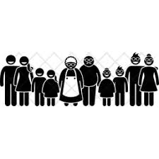



Informal jobs
Definition relies on the persons status in employment category (ICSE-18)
    Employers, Independent workers without employees
    Dependent contractors
    Employees
    Contributing family workers
    Have an informal job if they: “…operate and own or co-own an informal household unincorporated market enterprise...” i.e., they own and operate an informal enterprise.
    Operational criteria:
    Same criteria as for the sectors
    Registration, keeping account for tax purposes, institutional sector, incorporation, engaging a formal employee
    A new category of status in employment
    DC have an informal job if they“…do not have a formal status or whose activities are not effectively covered by formal arrangements.”
    Operational criteria:
    Whether they have an registered enterprise or are registered for tax on profits and;
    Have access to formal arrangements such as social insurance
    Have an informal job if the job is“ …not in practice, formally recognized by the employer in relation to the legal administrative framework of the country or not associated with effective access to formal arrangements…”
    Operational criteria:
    Whether the employer contributes to social insurance on the behalf of the employee.
    Access to paid annual leave and paid sick leave
    Have informal jobs if the “…work relationships are not formally recognized in relation to the legal administrative framework of the country or not associated with effective access to formal arrangements”
    Operational criteria:
    In countries with no formal arrangements for CFW by default informal employment
    In countries that have formal arrangements:
    Formal status of the family business; Job registered; Contributions to social insurance

Slide 6
Informal employment
Definition relies on the persons status in employment category (ICSE-18)
    Employers, Independent workers without employees
INDEPENDENT WORKERS
We are using the same operational criteria for defining informal/formal jobs as is used to define whether the enterprise is informal or formal.
    Have an informal job if they: “Own and operates an informal enterprise...” As they would lack an effective coverage of formal arrangements.
    Operational criteria:
    Key criterion: Whether registered in a governmentally established system of registration.
    Keeping account for tax purposes, institutional sector, incorporation, engaging a formal employee
Formal job
Informal enterprise
Formal enterprise
Informal
job

Slide 7
Informal employment
Definition relies on the persons status in employment category (ICSE-18)
    Employers, Independent workers without employees
    Dependent contractors
    Employees
    Contributing family workers
    Have an informal job if they: “Own and operates an informal enterprise...” As they would lack an effective coverage of formal arrangements.
    Operational criteria:
    Key criterion: Whether registered in a governmentally established system of registration.
    Keeping account for tax purposes, institutional sector, incorporation, engaging a formal employee
    A new category of status in employment
    DC have an informal job if they“…do not have a formal status or whose activities are not effectively covered by formal arrangements.”
    Operational criteria:
    Whether they have an informal or formal economic unit or are registered for tax on profits and;
    Have access to formal arrangements such as contributes to social insurance
    Have an informal job if the job is“ …not in practice, formally recognized by the employer in relation to the legal administrative framework of the country or not associated with effective access to formal arrangements…”
    Operational criteria:
    Key criterion: Whether the employer contributes to social insurance on the behalf of the employee.
    Access to paid annual leave and paid sick leave
    Have informal jobs if the “…work relationships are not formally recognized in relation to the legal administrative framework of the country or not associated with effective access to formal arrangements
    Operational criteria:
    In countries with no formal arrangements for CFW by default informal employment
    In countries that have formal arrangements:
    Formal status of the family business; Job registered; Contributions to social insurance

Slide 8
Informal employment
Definition relies on the persons status in employment category (ICSE-18)
    Dependent contractors
    Employees
    Contributing family workers
    A new category of status in employment
    DC have an informal job if they“…do not have a formal status or whose activities are not effectively covered by formal arrangements.”
    Operational criteria:
    Whether they have an informal or formal economic unit or are registered for tax on profits and;
    Have access to formal arrangements such as contributes to social insurance
    Have an informal job if the job is“ …not in practice, formally recognized by the employer in relation to the legal administrative framework of the country or not associated with effective access to formal arrangements…”
    Operational criteria:
    Key criterion: Whether the employer contributes to social insurance on the behalf of the employee.
    Access to paid annual leave and paid sick leave
    Have informal jobs if the “…work relationships are not formally recognized in relation to the legal administrative framework of the country or not associated with effective access to formal arrangements
DEPENDENT WORKERS
We need additional criteria to define informal and formal jobs.
The informal/formal status of the economic unit is not sufficient.
    Operational criteria:
    In countries with no formal arrangements for CFW by default informal employment
    In countries that have formal arrangements:
    Formal status of the family business; Job registered; Contributions to social insurance

Slide 9
Status in employment informal- formal job, sector
Sector of the economic unit for which the work is carried out | Job by status in employment
 | Independent workers (Employers, own-account workers) |  |  | Dependent workers
 | Owner-operators of corporations | Independent workers in household (unincorporated) market enterprises |  | Dependent contractors* |  | Employees |  | Contributing family workers
 | Formal | Informal | Formal | Informal | Formal | Informal | Formal | Informal | (Formal)
Formal sector |  |  |  | 1 |  | 2 |  | 3
Informal sector |  | 4 |  | 5 |  | 6 |  | 7
HOC-sector |  |  |  |  |  | 8
Cells shaded in dark grey refer to jobs, which, by definition, do not exist in economic units located in the specific sector. Cells shaded light grey refers to formal jobs. Informal employment consists of informal jobs in cells 1-8
*The sector of dependent contractors does not reflect the sector of the economic unit on which they depend but the sector in which the dependent contractor is categorized.

Slide 10
ICSE
- Essential for defining informal and formal jobs

Slide 11
ICSE-18
20th ICLS resolution concerning statistics on work relationships (2018)
Replaced ICSE-93.
ICSE-18 consists of 10 detailed categories that can be organized in two hierarchies.
According to type of authority
  Dichotomy between independent workers and dependent workers.
According to type of economic risk
  Dichotomy between workers in employment for pay versus workers in employment for profit.

Slide 12
Classification
ICSE-18 provides 10 detailed mutually exclusive categories of status in employment.
ICSE-18 detailed categories
11. Employers in corporations
12. Employers in household market units
21. Owner-operators of corporations without employees
22. Own-account workers in household market units without employees
30. Dependent contractors
41. Permanent employees
42. Fixed-term employees
43. Short-term and casual employees
44. Paid apprentices, trainees and interns
51. Contributing family workers
  Differences compared to ICSE-93
  Two detailed categories of employers
  Two detailed categories of own-account workers
  The new category of dependent contractors
  Four detailed categories of employees
  Members of producers' cooperatives do no longer constitute its own status in employment
  CFW
The 10 detailed categories can be organised according to two different hierarchies

Slide 13
ICSE-18-A
Based on the type of authority that the worker is able to exercise in relation to the work performed
  Creates a dichotomy between independent workers and dependent workers.
  Suitable for various types of labour market analysis.
  Creates the basis for defining informal and formal employment

Slide 14
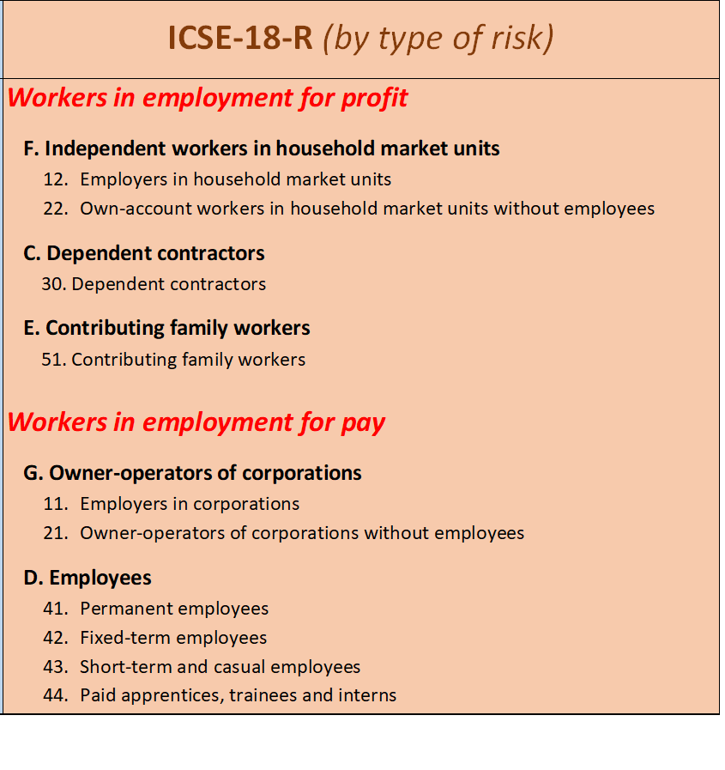
ICSE-18-R
  Based on the type of economic risk to which the worker is exposed
  Creates a dichotomy between workers in employment for profit and workers in employment for pay.
  Suitable for the provision of data for national accounts, for the identification of wage employment.

Slide 15
Dependent contractors
A new category of status in employment
One of the most important changes but also one of the more challenging
Different terms have been used to describe this group such as “Dependent self-employed, disguised employment relationships, sham self-employment etc.”
A challenge for many statistical agencies in both the developed and developing world.
  Frequently classified either as own-account workers or as employees but no clear treatment
In-between situation (on the boundary between own-account workers in household market enterprises and employees)

Slide 16
Dependent contractors: examples
Workers with a commercial agreement
Hairdressers who ‘rent’ a chair in a hairdressing salon
  purchase their materials (shampoos, dyes etc.) from the salon owner
  owner decide on the price of the services, allocates the clients.
  receive payment from their customers but must pay a portion of that to the salon owner.
Vehicle drivers who works for a transport company but are considered by the company as self-employed
  Transport company provides work and determines the payment
  But takes no responsibility for workers’ compensation insurance, taxes and social contributions,
  these are the responsibilities of the driver.
  Digital platform worker: who receives clients through the digital platform
  The digital platform controls which clients the worker receives, and the prices for the services carried out by the worker and
  organizes the work by providing where and when the worker should provide the services
  The worker has a commercial agreement with the digital platform
Their activities are dependent on another entity
This entity exercise control over the activities (reduced authority)

Slide 17
Statistical definition
Workers who have contractual arrangements of a commercial nature (but not a contract of employment) to provide goods or services for or through another economic unit
Do not employ one or more persons as an employee
Do not have an incorporated enterprise
(These are characteristics they share with other independent workers)
Operationally and/or economically dependent on another entity that exercises control over their activities and directly benefits from the work performed by them.
(These are characteristics they share with other dependent workers)

Slide 18
Operational definition of formal and informal jobs
-Independent workers

Slide 19
Formal and informal jobs for independent workers
    Direct link between the formal/informal status of the job and the formal/informal status of the enterprise.
              For employers and independent workers without employees:
    The criteria used for defining the formal and informal sector is therefore also used for defining formal and informal jobs for independent workers
Formal enterprise
Formal job
Informal enterprise
Informal job

Slide 20
Operational definition of formal and informal jobs dependent workers
-Dependent contractors
-Employees
-Contributing family workers

Slide 21
Operational definition of formal and informal jobs dependent workers
-Dependent contractors
-Employees
-Contributing family workers

Slide 22
Formal and informal jobs for DC
    Have a formal job if:
              Person have a formal status as a worker in employment for profit in relation to the legal administrative system of the country; and
              Have an effective access to formal arrangements that reduce their economic risk.
    An informal job if this is not the case
              They do not have a formal status in relation to the legal administrative system of the countries; or
              they have a formal status but lack an effective access to formal arrangements.

Slide 23

A. Formal status as a worker in employment for profit
    DC have a formal status and is categorized in the formal sector if they:
    Own and operate a formal enterprise; or
    Registered in relation to tax on profits.
    If the DC do not have a formal enterprise and is not registered in relation to tax on profits
              Do not have a formal status, categorized in the informal sector.
              Then no formal recognition of the activities, and the person as a worker for profit, would in a sense be “invisible”.

Slide 24

B: Effective access to formal arrangements
    In most countries: No direct link between registration and access to formal arrangements such as job-related social insurance
              A need to add a criterion capturing whether the dependent contractor contributes to voluntary job-related social insurance on own behalf.
    Some countries; directly linked to being registered.
              Having a registered enterprise or being registered for tax implies a coverage of formal arrangements such as social protection.

Slide 25
Countries will have to assess their system
Is the DC registered?
Does sufficient formal arrangements come with being registered?
NO
Yes
Business register
Additional criterion of contributions to social insurance
Formal job
in the formal sector
No
Yes
Yes
Registration in relation to profits
Informal job
In the informal sector
No
Informal job
in the formal sector
No

Slide 26
Countries will have to assess their system
Is the DC registered?
Does sufficient formal arrangements come with being registered?
Yes
Yes
Business register
Formal job
in the formal sector
No
Registration in relation to profits
Yes
Informal job
In the informal sector
No

Slide 27
Operational definition of formal and informal jobs dependent workers
-Dependent contractors
-Employees
-Contributing family workers

Slide 28
Employees and informal jobs
    Employees are considered to have informal jobs:
“If their employment relationship is not, in practice, formally recognized by the employer in relation to the legal administrative framework of the country; or
is not effectively covered by formal arrangements such as labour legislation, social protection, income taxation or entitlement to employment benefits”
    Includes:
  permanent employees;
  fixed-term employees;
  short-term and casual employees; and
  paid apprentices, trainees and interns,
  who do not have access to effective formal arrangements such as statutory social insurance, access to paid annual leave and paid sick leave.
The definition needs further operationalization:
which precise criteria to use and how to combine them

Slide 29
Stronger recommendations for operationalization
    Employers' contribution to social insurance –A prioritized criterion
              If contributions are made to a statutory social insurance (i.e., a social insurance anchored in national legislation/social security laws) then: a formal job.
              A defining characteristics for informal jobs is an absence of contributions.
              Operationalization: Countries need to operationalize the criterion taken the national social protection system into account.
              Typically, it would be contribution to a pension, but could also be other relevant social insurances.

Slide 30
Stronger recommendations for operationalization
    Access to paid annual leave and paid sick leave - Relevant criteria:
              Either as part of the main criteria or
              In case of insufficient information regarding employer´s contribution to social insurance.
              Both conditions need to be met for the job to be considered formal.
              If only access to paid annual leave or paid sick leave, then informal job.
    Additional national characteristics - Supporting criteria:
              Recognition of the possibility to use additional national criteria (absence of a written contract, parental leave etc. )
              However, countries are strongly recommended to include the three criteria of social insurance, access to paid annual leave and paid sick leave.
              Possibility to produce regional and global estimates.
              Important indicators to provide a context of the degree of protection.

Slide 31
Summery
Contributions to SI always defines the job as formal
There is the option to either:
Define jobs as informal if no contributions are made
and in the case of don’t know define the job as formal if access to paid annual leave and paid sick leave
And finally use additional “national criteria” if relevant
No
Employer’s contribution to social insurance
Yes
Formal job
Informal job
DK
No
Access to paid annual leave
Yes
No
Access to paid sick leave
Yes
Additional “national” criteria
    The expectation is that employer’s contribution to statutory social insurance, access to paid annual leave and paid sick leave are part of the measurement and asked to all employees
    Countries can add additional characteristics if relevant/needed
    Still some flexibility of how to combine the criteria, but more reduced

Slide 32
Summery
Contributions to SI always defines the job as formal
Or if relevant (due to e.g. universal SI system or no existing SI insurance), define the job as formal if:
no contributions are made
or in the case of don’t know define the job as formal if access to paid annual leave and paid sick leave
And finally use additional “national criteria” if relevant
Employer’s contribution to social insurance
Yes
Formal job
Informal job
NO
DK
No
Access to paid annual leave
Yes
No
Access to paid sick leave
Yes
Additional “national” criteria
    The expectation is that employer’s contribution to statutory social insurance, access to paid annual leave and paid sick leave is part of the measurement
    Countries can add additional criterion if relevant/needed
    Still some flexibility of how to combine the criteria, but more reduced

Slide 33
Operational definition of formal and informal jobs dependent workers
-Dependent contractors
-Employees
-Contributing family workers

Slide 34
Defining informal and formal jobs for CFW
    Previous definition; CFW had informal jobs by default
              Rested on the assumption that jobs held by CFW are informal by nature.
              However, in some countries CFW can register and gain access to formal arrangements such as job-related social insurance.
              At the same time in many countries no such arrangements are in place for CFW.
    Definition in the 21st ICLS resolution
    In countries where no formal arrangements are in place for CFW
              The practice of by default define their job as informal can be maintained.

Slide 35
Defining informal and formal jobs for CFW cont.
    In countries that have formal arrangement in place:
    The job can be considered formal if:
              The family business is formal; and
              the CFW is registered as a CFW; and
              Have access to formal arrangements such as contributions are made to a social insurance.
    The job is informal if:
              The family business is informal; or
              the CFW is not registered as a CFW; or
              contributions are not made to a social insurance.
    This change
              Points towards a possible formalization of CFW, beyond shifting their status in employment category.
              Recognizes the formal arrangements in place in some countries.
              Enables to measure the outreach of these policies.
              Has important gender implications

Slide 36
Partly informal productive activities

Slide 37
A complementary concept
    The concept would be a complement to the core concepts of informal employment and informal jobs
              Whether or not it is used would depend on the country context.
              Ex1. employee that is contracted to work few hours (10h) but then in addition is working 20 paid hours per week and these 20 paid hours are undeclared, the employee do not receive any contributions to social insurance for these hours and if sick or if the person takes leave the worker would not get any compensation for these hours.
              Ex2. Independent own-account worker working as carpenter and were some of the work carried out is declared while another part is undeclared.
              These persons would share some characteristics with workers in informal jobs and in particular the employee would face a higher economic risk.
              Would have relevance in particular high-income countries.

Slide 38
Definition:
    Includes employees, independent workers and DC with formal jobs, where parts of the activities are not covered by formal arrangements:
              Employees: when part of the earnings and paid hours worked are not declared for taxation or mandatory job-related social contributions
              Independent workers and DC: when part of the income is not declared for taxation.

Slide 39
Essential categories of informal unpaid work

Slide 40
Essential categories
    Objective is to indicate groups among informal unpaid work that are of particular statistical interest to measure with some regularity, to complement the concept of informal employment.
    This includes categories that previously have been part of informal employment and where it would be particularly useful from user/policy perspective to more regularly provide data on.
    The two categories are:
              Subsistence foodstuff producers
              Unpaid trainees
    However, additional categories or domains of informal work can be identified depending on the national need and context for specific analytical or policy interest.

Slide 41
Subsistence food-stuff producers
    Essential category that should be regular measured
    It is a significant group in some countries and a vulnerable group.
    Production would typically be informal.
    They were part of countries previous measurement of informal employment.
    Strong need to be measured as a complement to the estimate on informal employment, in countries that have a significant share.
    Provides a more complete picture on the structure of informality within these countries.

Slide 42
Thank you

